Slide 1
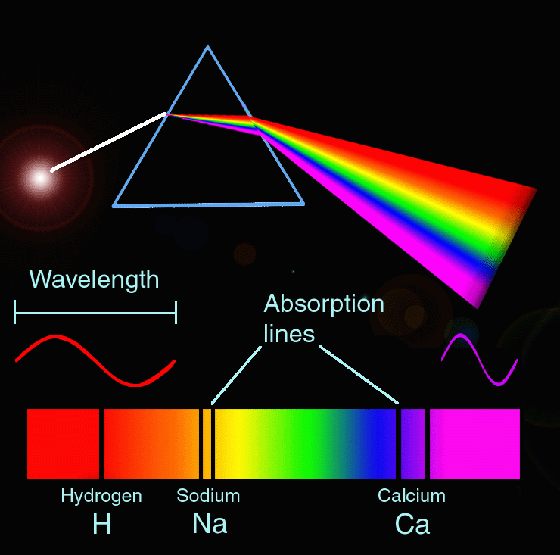
Spectroscopy
The study of the interaction between matter and light

Slide 2
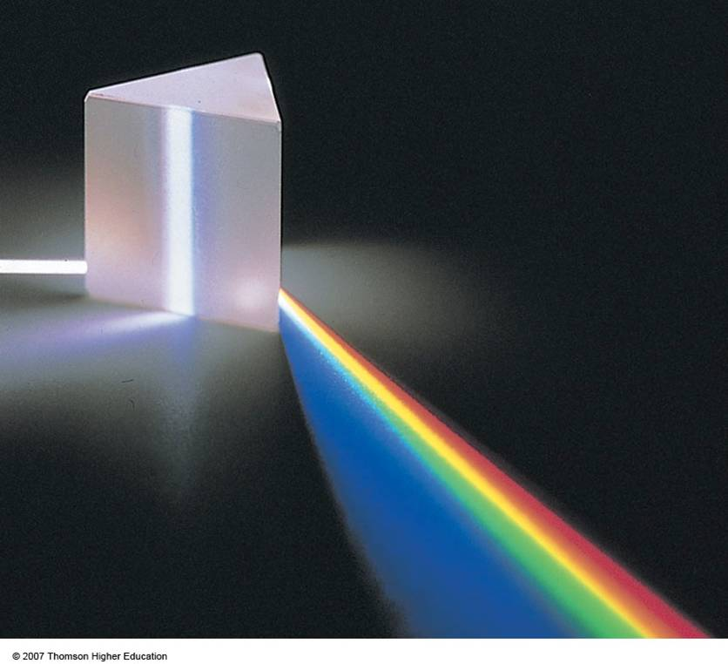
The white light from stars can be separated out into its different wavelengths using a prism or diffraction grating

Slide 3
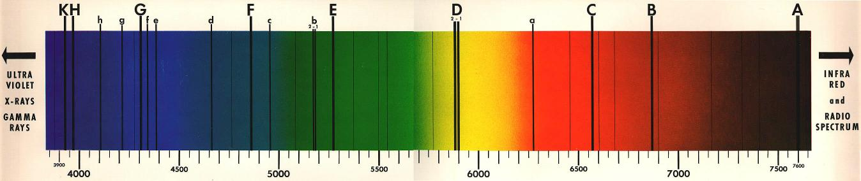
However if you look at the spectrum from our own sun, it is not continuous, it has dark lines in it
Lines C, F and h are caused by hydrogen
These are called Fraunhofer lines and tell us what elements are present in the sun

Slide 4
What causes these dark lines?
Light travelling from the Sun needs to pass through the Sun’s atmosphere
Elements present in the Sun’s atmosphere will absorb some of this light at characteristic wavelengths

Slide 5
Excited state
Energy
Ground state
Energy from light is absorbed by an electron to move it to an excited state

Slide 6
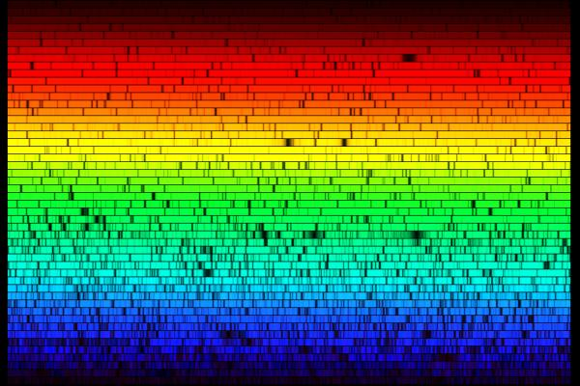
Spectrum of the cool giant star Arcturus

Slide 7
Let’s make a spectroscope!!

Slide 8
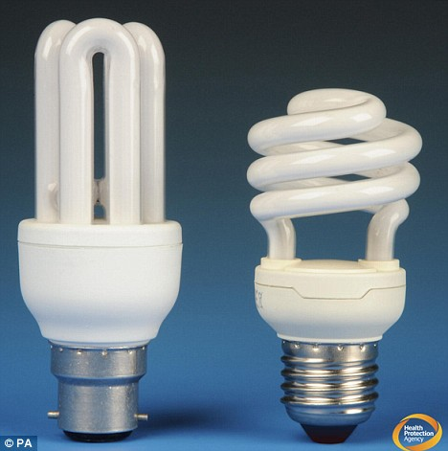
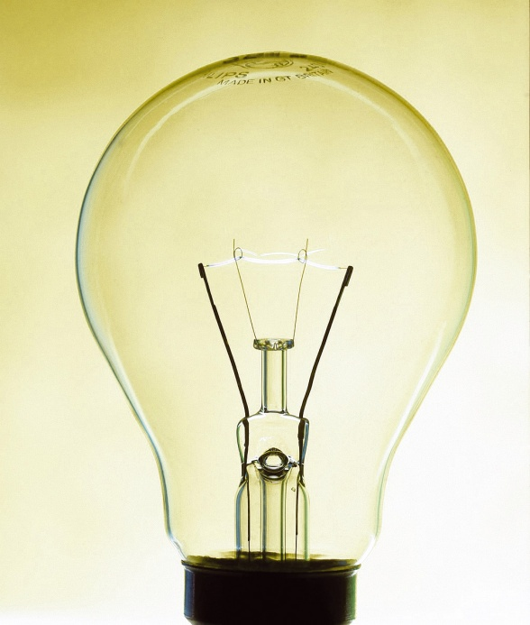
View the tungsten filament lamp and the fluorescent light. What do you notice?

Slide 9
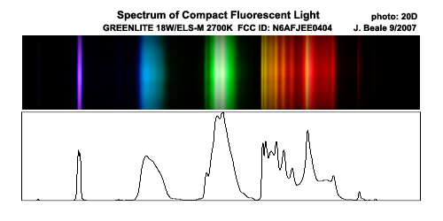
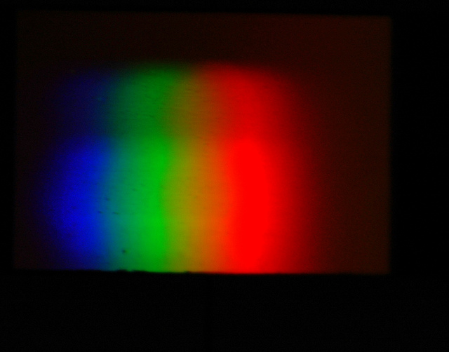
Fluorescent light
The new type of fluorescent bulb give discrete bands due to flurorescence of rare-earth based phosphors developed recently
Tungsten filament
Solids, like the tungsten filament here, when heated tend to give a continuous spectrum

Slide 10
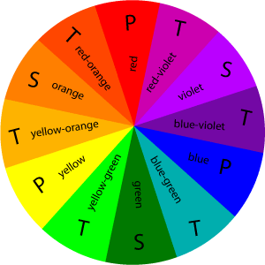
Let’s observe the absorption of light by some chemicals in solution
Potassium permanganate solution
Cobalt (II) chloride – cool and hot
What do you notice about the colour of the light absorbed compared with the colour of solution?

