Slide 1
Masterclass
Notes for use:
When printing this presentation, first save as Adobe .pdf. Then print the pdf.
This will ensure the output page fits A4.

Slide 2

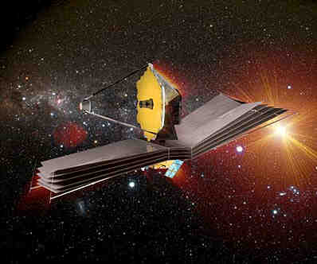
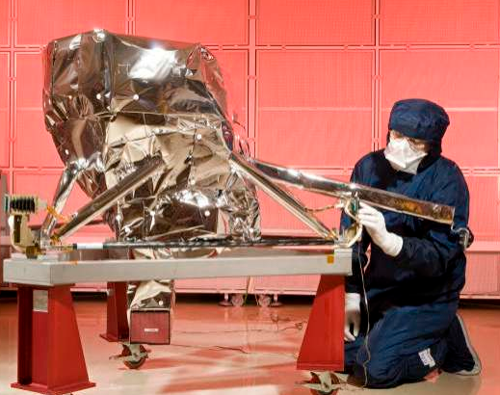
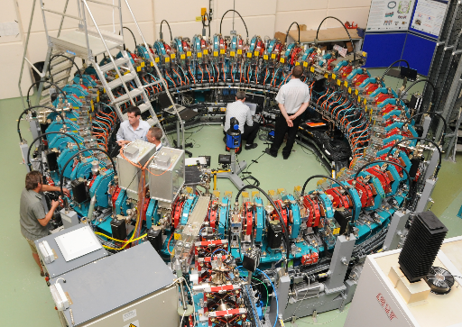
MIRI
James Webb Space Telescope
Particle accelerator - Daresbury

Slide 3
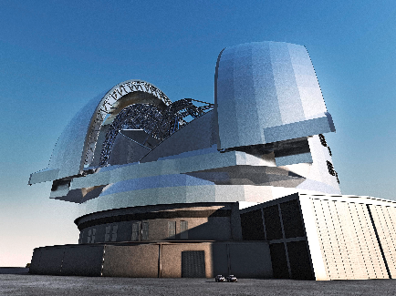
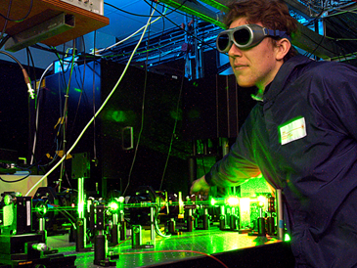
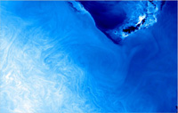
Central Laser Facility
European Extremely Large Telescope (ELT)
ENVISAT image of the Gulf of Oman

Slide 4
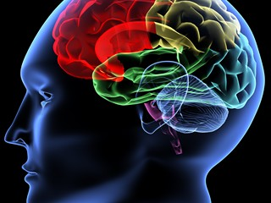
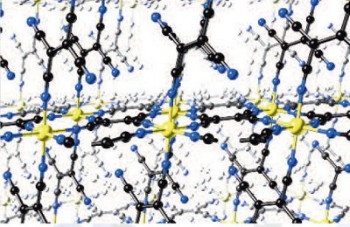
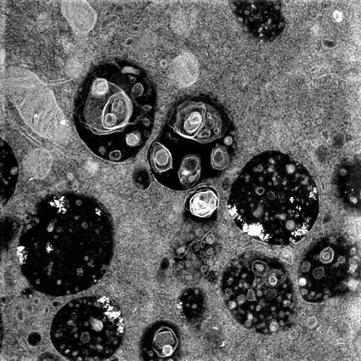
Computer Modelling
Medical Physics – Scanning and Imaging
STEM/HAADF Image of the cytoplasm of a dendritic cell

Slide 5
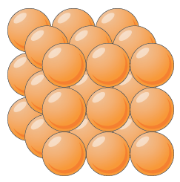
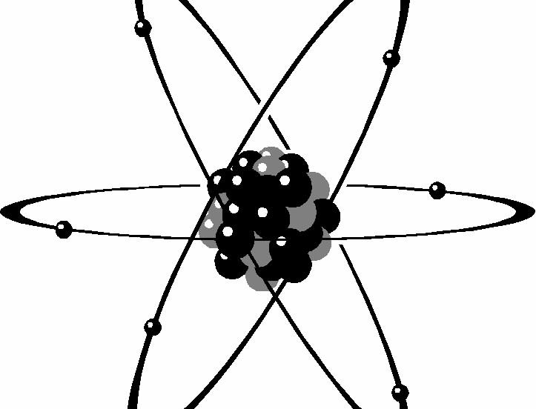
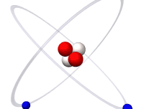
What is the smallest thing you can think of?
What is ‘stuff’ made from?
Atoms are not as small as it gets
What is the charge of:
A proton?
A neutron?
An electron?
Everything is made out of atoms
Helium Atom

Slide 6
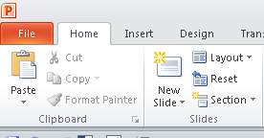


Scale Model Activity
Notes for use:
If you accidentally move anything on this slide go to
Home/Slides/Reset
Your picture must be the same size as the space opposite if you import it into the box. Otherwise it will resize disproportionately…
Alternatively paste your picture in. Click on it and a Picture Tools menu appears above Format.
All the tools you will need to resize, crop and align are there.

Slide 7
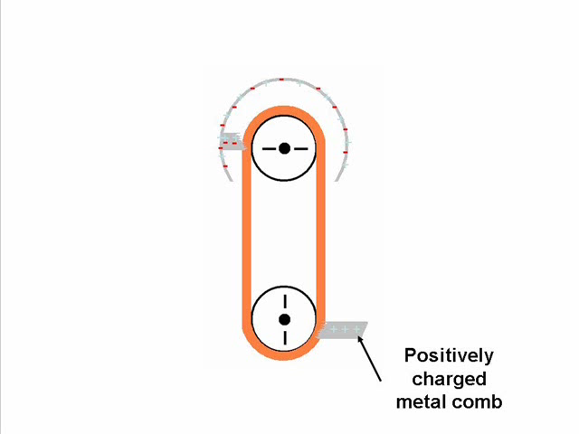
Investigating electrons
Notes for use:
If you accidentally move anything on this slide go to
Home/Slides/Reset
Your picture must be the same size as the space opposite if you import it into the box. Otherwise it will resize disproportionately…
Alternatively paste your picture in. Click on it and a Picture Tools menu appears above Format.
All the tools you will need to resize, crop and align are there.
What will happen if two electrons will be brought close to each other?
Why do metals conduct electricity?
What can happen when you brush against your car after a long journey?
How does this relate to particle accelerators?

Slide 8
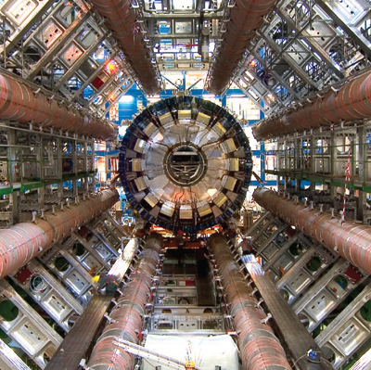
How can we get even smaller?
Notes for use:
If you accidentally move anything on this slide go to
Home/Slides/Reset
Your picture must be the same size as the space opposite if you import it into the box. Otherwise it will resize disproportionately…
Alternatively paste your picture in. Click on it and a Picture Tools menu appears above Format.
All the tools you will need to resize, crop and align are there.
The ATLAS detector at CERN

Slide 9
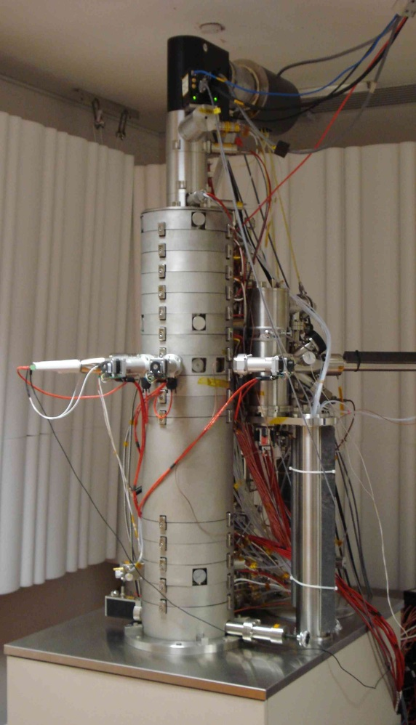
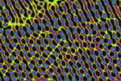
Imaging the smallest things possible
Notes for use:
If you accidentally move anything on this slide go to
Home/Slides/Reset
Your picture must be the same size as the space opposite if you import it into the box. Otherwise it will resize disproportionately…
Alternatively paste your picture in. Click on it and a Picture Tools menu appears above Format.
All the tools you will need to resize, crop and align are there.
Super STEM (Scanning Transmission Electron Microscope) at Daresbury.
Uses a fine beam of electrons to analyse samples.
Can be used to observe how nanotechnology interacts with biological matter.
STEM/HAADF Image of the cytoplasm of a cell
STEM/HAADF Image of graphene ripples

Slide 10
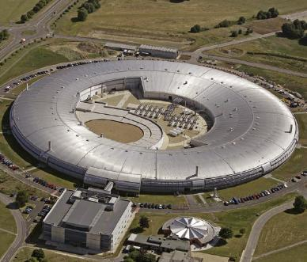
Particle Racetracks
ATLAS detector - Cern
Diamond Light Source
Particle collisions

Slide 11
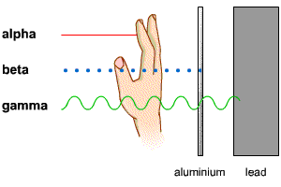
Radiation

Slide 12
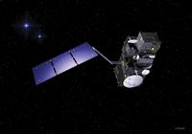
A bigger sphere
How can we tell what the temperature is from space?
ENVISAT
We don’t have a big enough thermometer!
By observing the Earth from space we can find out lot of important things
Sea and Land Surface Temperature Radiometer

Slide 13
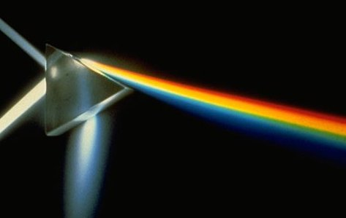
Light and colour

Slide 14
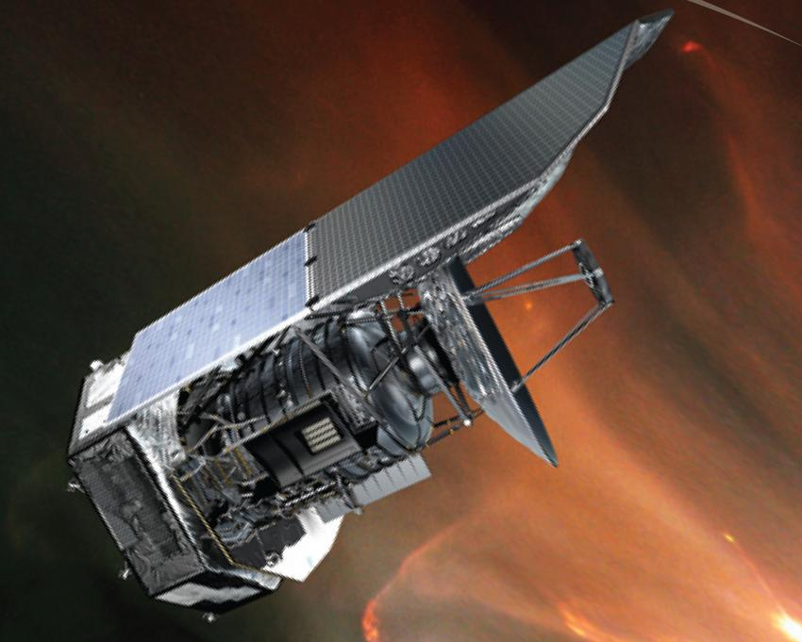
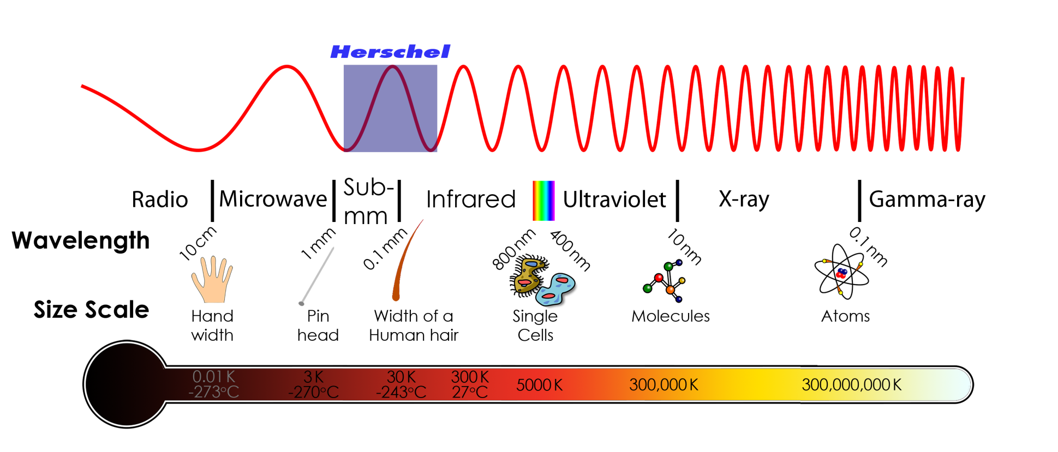
Different kinds of ‘light’
What is the science name for heat energy?

Slide 15
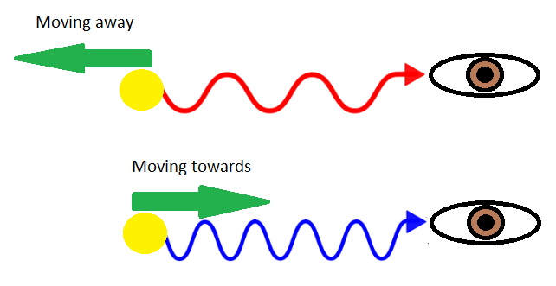
Red Shift
Apart from some local objects everything is red shifted – the Universe is expanding!
Notes:
Extension for more able students

Slide 16
Seeing into the past
The James Webb Space Telescope
Notes:
Extension for more able students

Slide 17
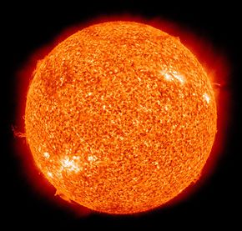
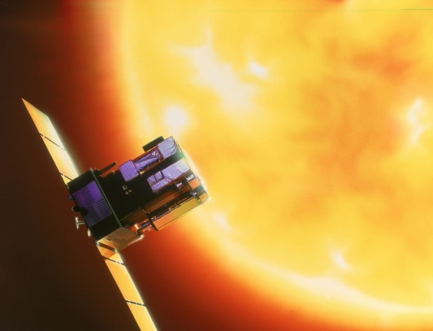
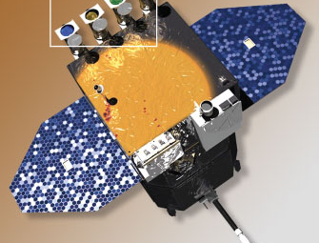
What do we know that gives off lots of light AND heat?
By what process does light from the Sun reach the Earth?
SOHO
As well as visible and infrared, what else does the Sun produce?
If we use lots of different types of light we can find out more!
SDO

Slide 18
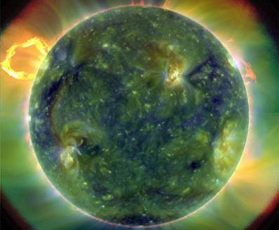
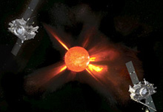
Observing the Sun?
STEREO
SDO – UV image
SOHO solar flare

Slide 19
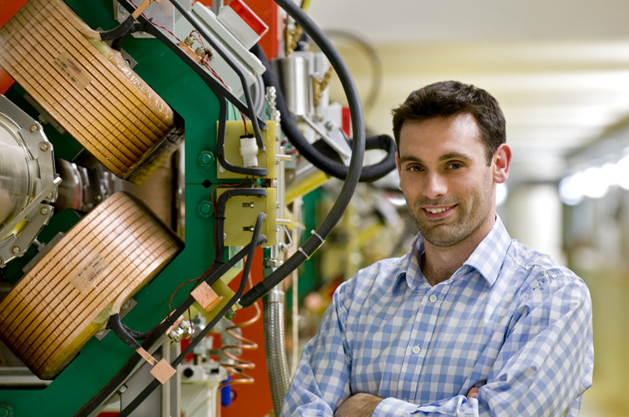
It could be you

