Slide 1
Rosetta – Unlocking the Secrets of the Solar System
Dr Ross Burgon, Department of Physical Sciences, The Open University

Slide 2
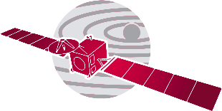

Rosetta - Introduction
First spacecraft to orbit a comet’s nucleus
First spacecraft to fly alongside a comet as it heads towards the inner Solar System
First spacecraft to examine from close proximity how a frozen comet is transformed by the warmth of the Sun
First controlled touchdown on a comet nucleus
First images from a comet’s surface and make the first in situ analysis to find out what it is made of
First European close encounter with asteroids
First spacecraft ever to fly close to Jupiter’s orbit using solar cells as its main power source

Slide 3
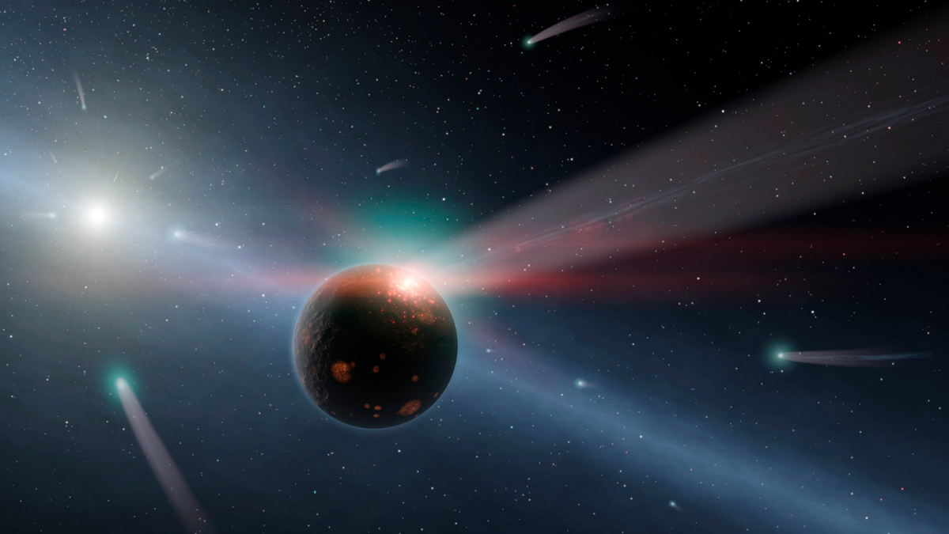
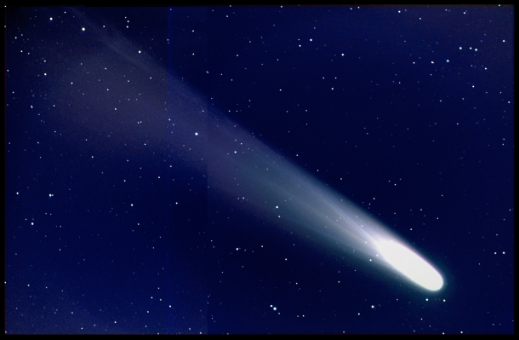
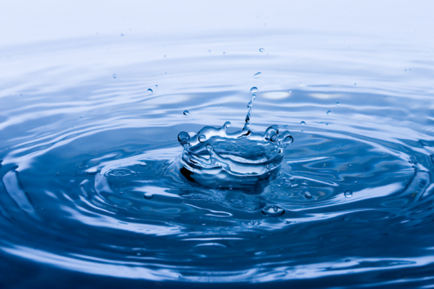
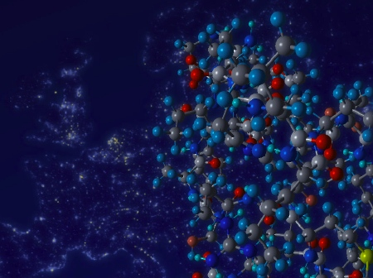
Rosetta - Science
To help understand the origin and evolution of the solar system

Slide 4
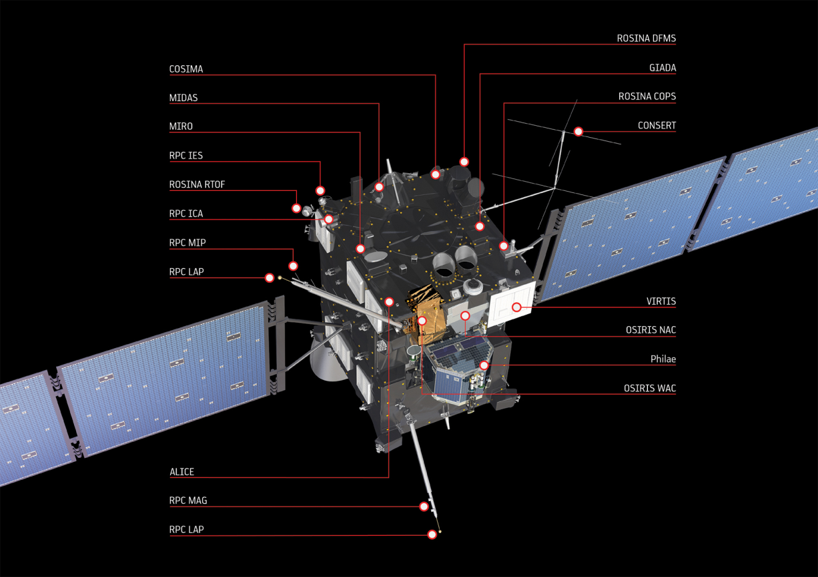
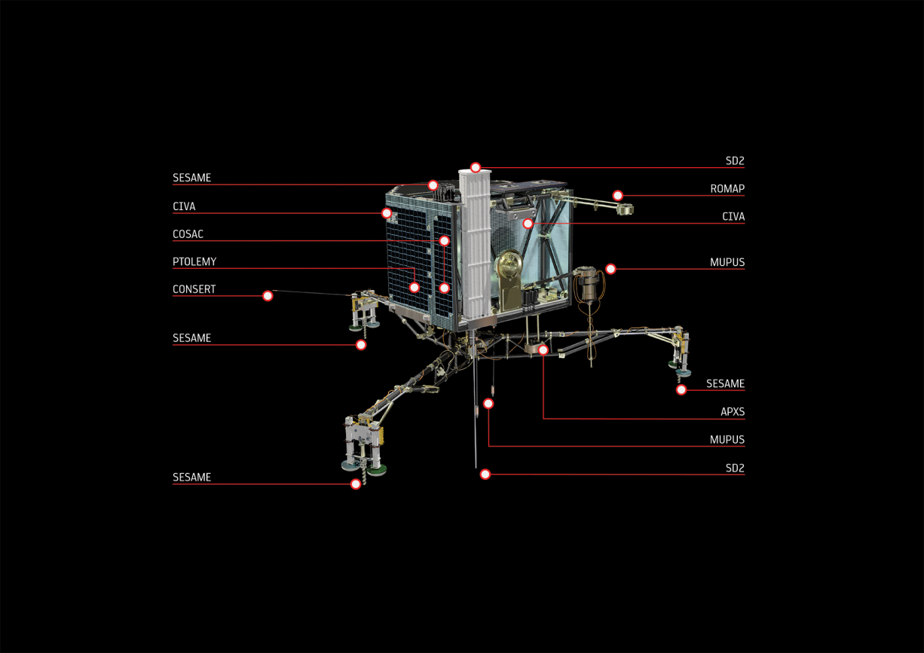
Rosetta – Spacecraft
Philae stats
85 x 85 x 60 cm (main body)
100kg mass
10 instruments
Rosetta stats
2.8 x 2.1 x 2.0 m (main body)
32 m solar arrays
3,000kg mass
11 instruments

Slide 5
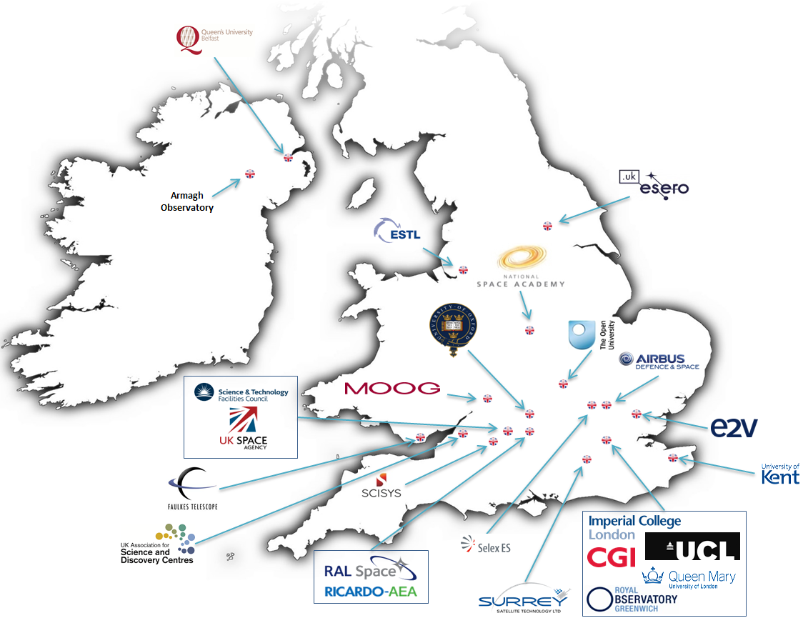
Rosetta – In the UK
Academia
Industry
Government
Educators

Slide 6
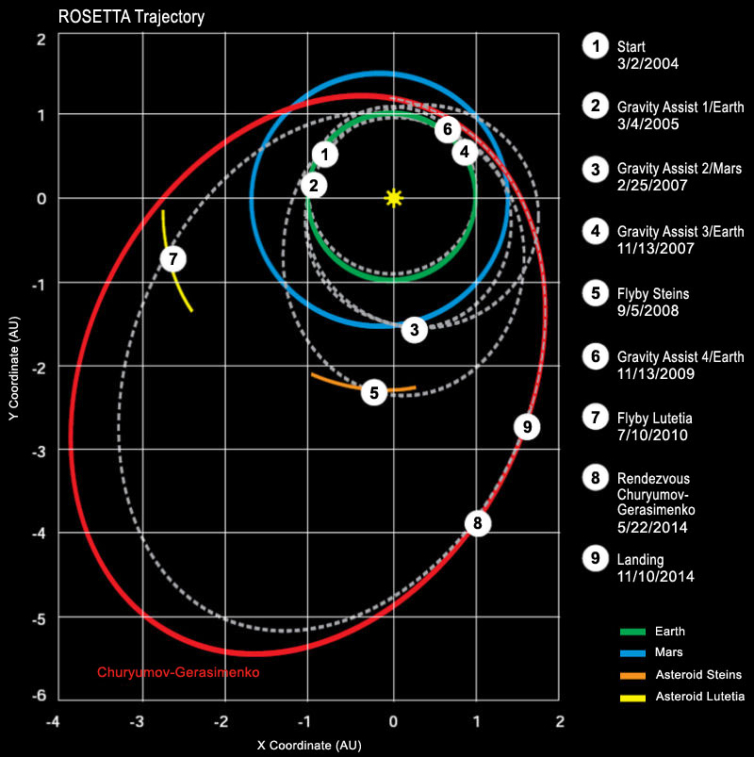
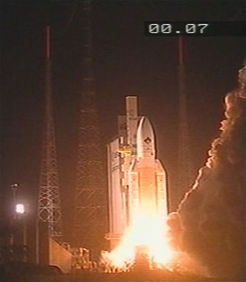
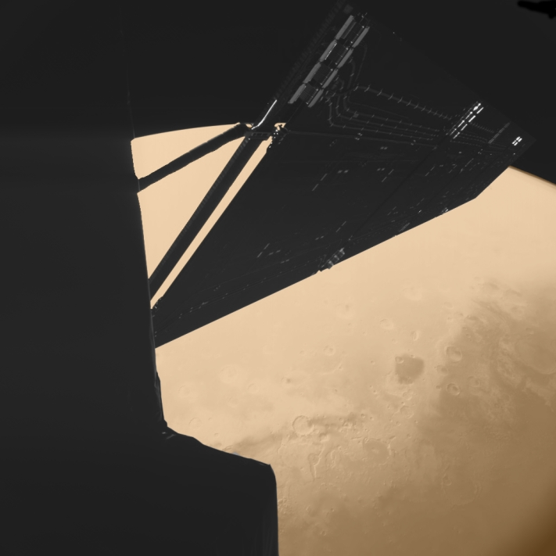
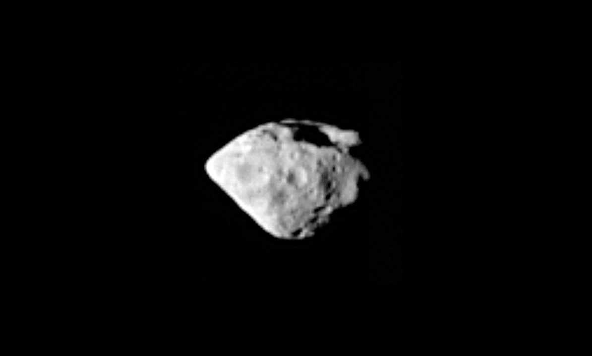
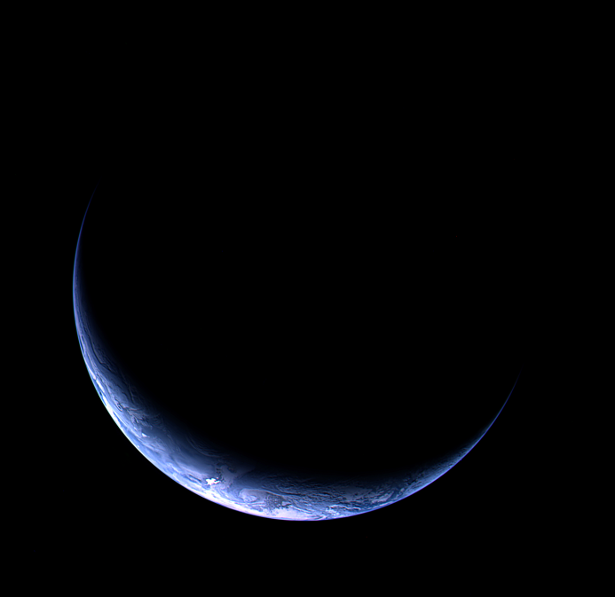
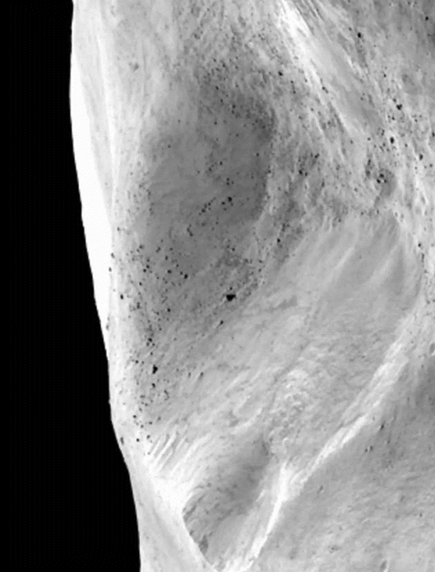
Rosetta – Mission

Slide 7
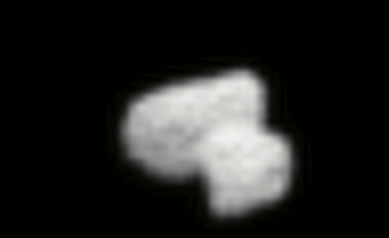
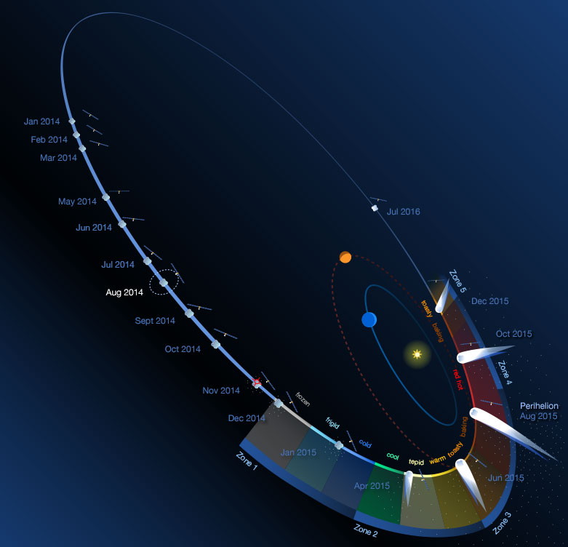
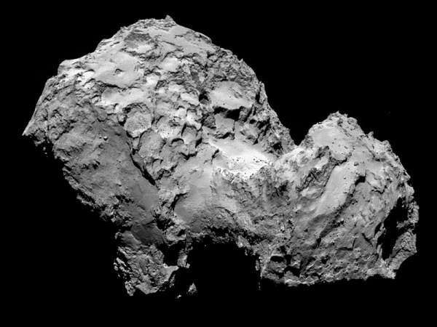
Rosetta – what’s happening next?
14 July
http://rosetta.jpl.nasa.gov/sites/default/files/rosetta_info/index.html
6 August

Slide 8
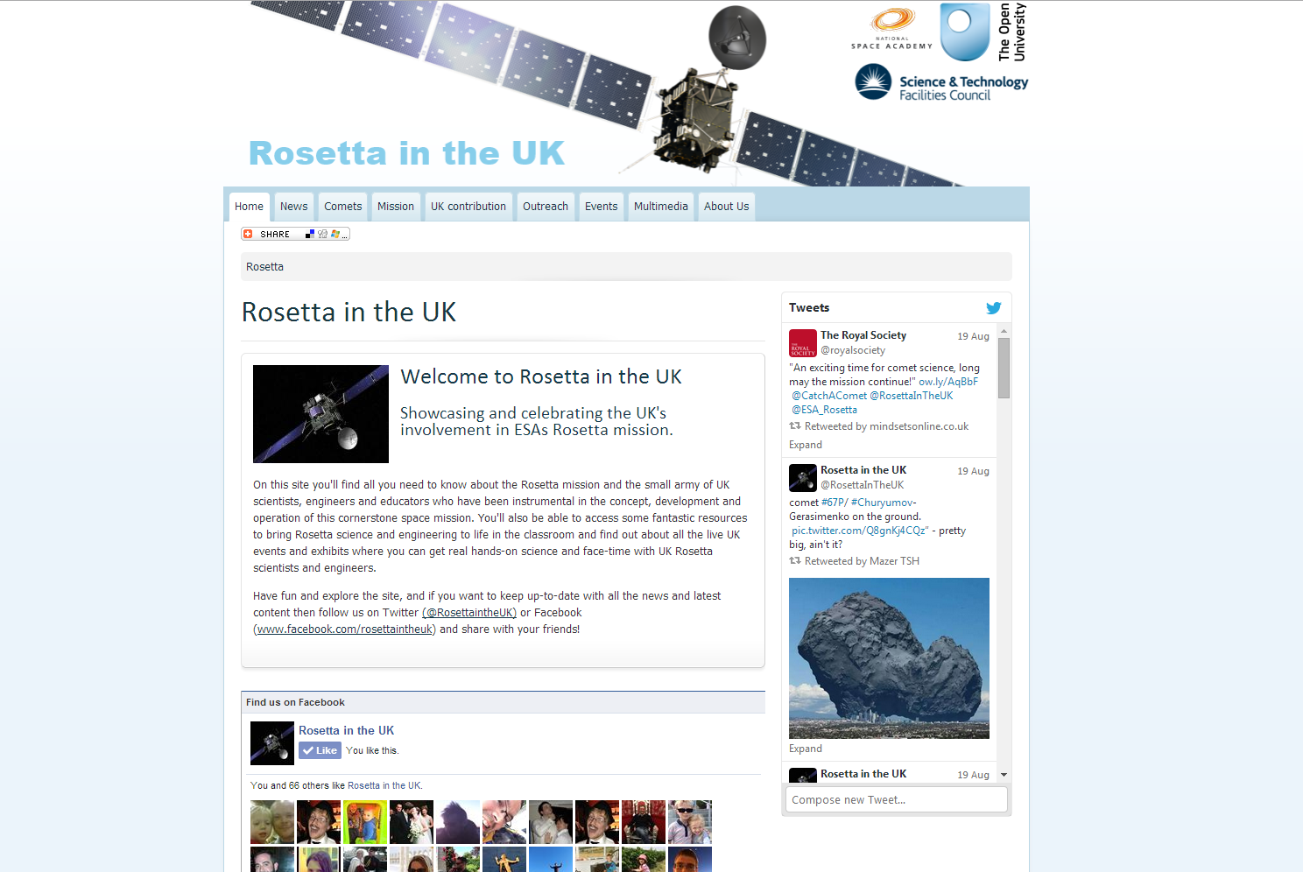
www.rosetta.ac.uk

Slide 9
How can I find out more?
www.rosetta.ac.uk
http://sci.esa.int/rosetta/
Twitter
  @RosettaInTheUK
  @ESA_Rosetta

