Slide 1
DNA Structure
Notes for use:
When printing this presentation, first save as Adobe .pdf. Then print the pdf.
This will ensure the output page fits A4.

Slide 2
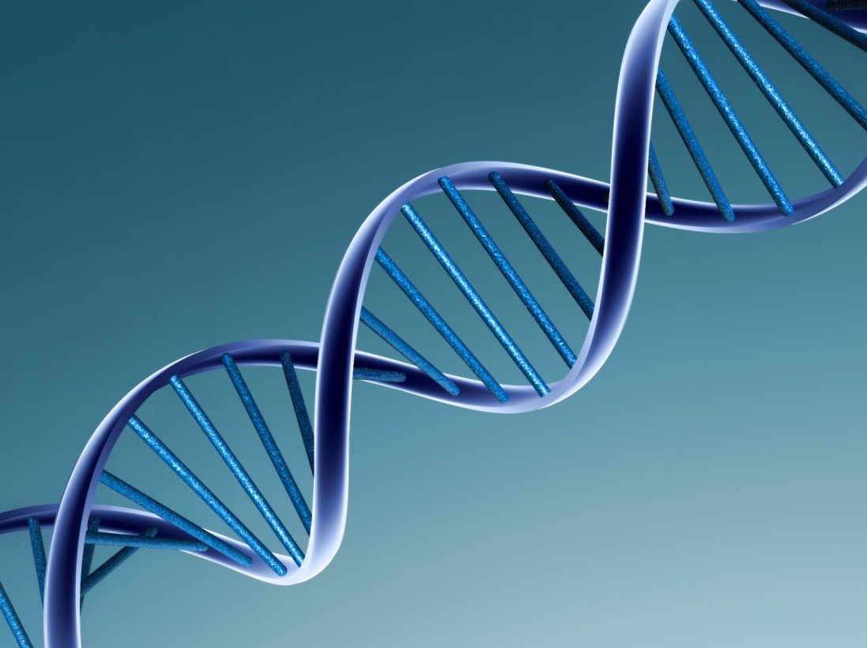
How did we work out the structure of DNA?
Notes:
The UK has led the way in DNA breakthroughs since the very beginning of DNA research. So how did we work out what DNA looked like?

Slide 3
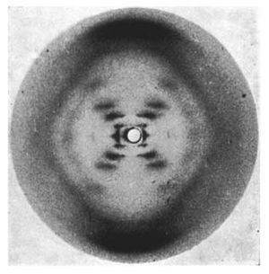

It is not just crystals that we can investigate with diffraction…
Notes:
Rosalind Franklin and Raymond Gosling used the above picture (photo 51 – above) to work out the shape and size of DNA in 1952. The above picture is of Rosalind Franklin. However, picture 51 does not really look like a strand of DNA – so what are we seeing?

Slide 4
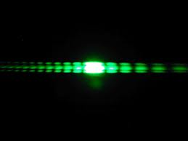
Diffraction Gratings
Notes:
The key to unlocking the structure of DNA came from a light effect called diffraction, which we can demonstrate really nicely here (see handbook for information on how to do the diffraction grating demo).

Slide 5

Light travels as waves
Screen
But for now we’ll draw it as a straight line
Notes:
Light travels as waves, but to simplify the situation in these animations we are going to represent the wave as a straight line.

Slide 6
As the waves pass through the gaps they are diffracted (bent/change direction)
Notes:
As the light passes through the gaps it is ‘bent’ around the gaps (if the gaps are similar in size to the wavelength of the light). As a result, on the screen you will get light from different rays (and different parts of the gaps) hitting the screen either in phase (so a crest with a crest, or trough with a trough) or out of phase (crest and a trough).

Slide 7

Some waves will add up (constructive interference) with others to create a ‘bright spot’
Constructive interference = bright spots
Notes:
If the light rays arrive in phases, then they will add together (or constructively interfere) to produce a really bright spot. Think of it as adding the amplitudes of the two waves together – if they are in phase you get a HUGE amplitude so a bright spot.

Slide 8

Some light interferes with sources from other gaps and cancels it out leaving a ‘black spot’.
Destructive interference = dark spots
Notes:
If the rays arrive out of phase (technically we say they have a phase difference of 180 degrees), then you have a trough and a peak adding together to give a net result of no amplitude – so you get a dark spot (of no light).

Slide 9
And if we know the distance to the screen and the distance between fringes we can work out the size of the gaps!

Slide 10
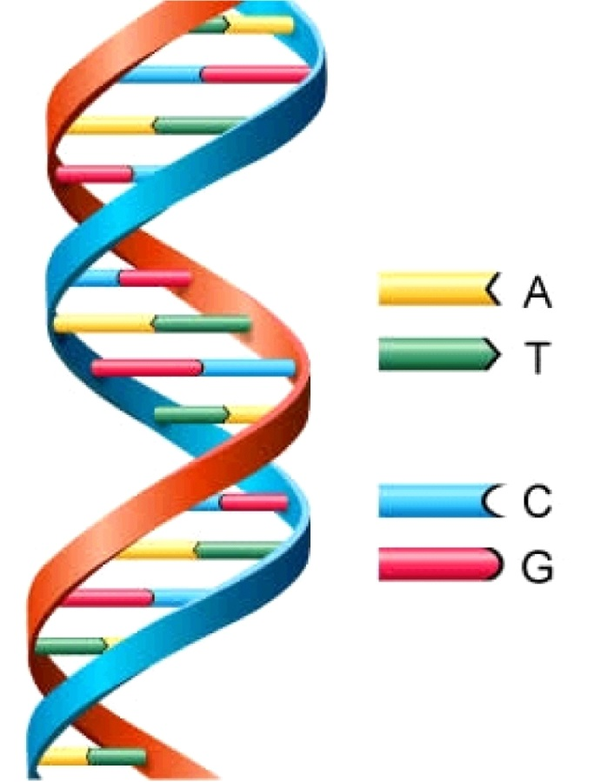
So how did we go from this…
To this?

Slide 11
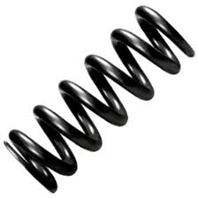
Notes:
Well, the same approach was used with DNA, the helix itself has a similar structure to a spring (which is basically a complex diffraction grating). We can demonstrate this by using the spring from a biro. If you shine a laser through the biro you should get the same kind of diiffraction pattern as was obtained in photo 51. By looking at the spacing you can understand the size of the ‘gaps’, and by looking at the angle of the ‘cross shape’ you can work out what the slope of the spiral is.

Slide 12
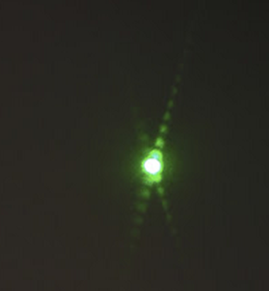
Notes:
You should get a pattern like this!

Slide 13
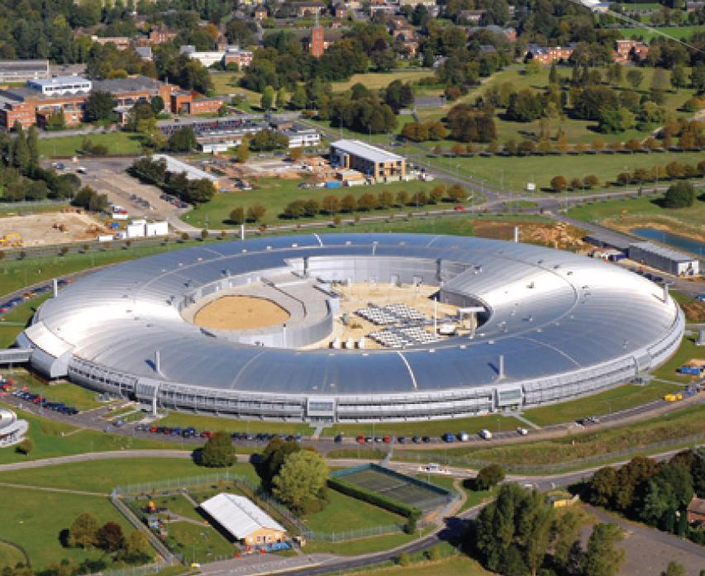
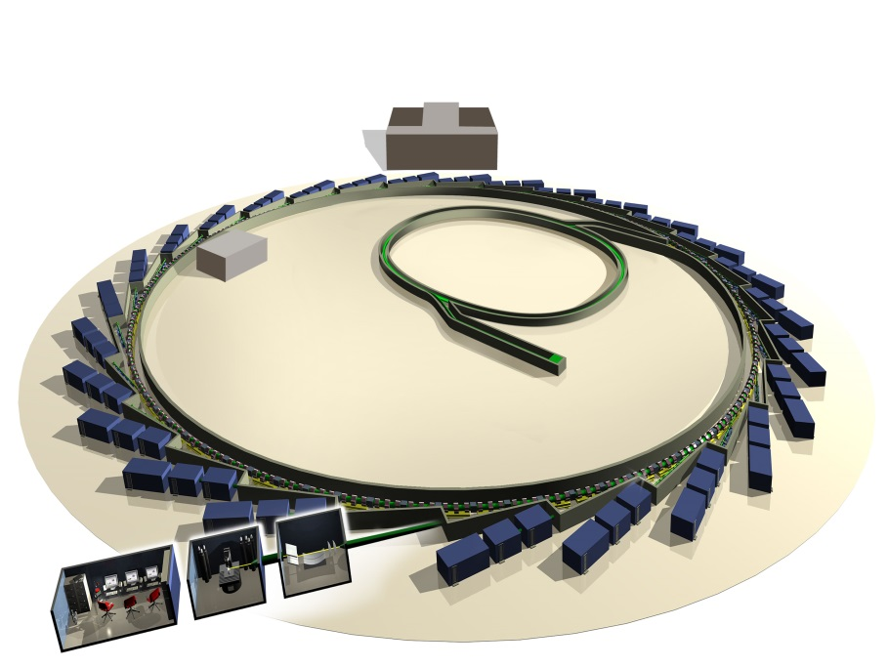
Of course the size of the ‘gaps in DNA are so small, we use X-rays instead of visible light
STFC’s Diamond Light Source
Notes:
Of course, DNA is much smaller than the spacings in the biro spring and so visible light would not work to get the results. What we end up using is much shorter wavelength Xray radiation produced from facilities like STFC’s Diamond Light Source above. For more info on Diamond Light Source and Xray crystallography go here: http://www.stfc.ac.uk/2396.aspx

